Slide 1
Azure Machine Learning
<title>
<name>

Slide 2
data science & AI
Key trends
challenges
Accelerating adoption of AI by developers (consuming models)
Rise of hybrid training and scoring scenarios
Push scoring/inference to the event (edge, cloud, on-prem)
Moving high-end developers into deep learning as non-traditional path to DS / AI dev
Growth of diverse hardware arms race across all form factors (CPU / GPU / FPGA / ASIC / device)
Demonstrating success of transfer learning techniques while reducing dev complexity
Data prep
Model deployment & management
Model lineage & auditing
Explain-ability

Slide 3
Azure Machine Learning
AZURE MACHINE LEARNING SERVICES
TRAIN & DEPLOY OPTIONS
Spark
SQL Server
Virtual machines
GPUs
Container services
AZURE
AI dev /
data scientist
workstation
CPU/GPU
ON-PREMISES
SQL Server
Machine Learning Server
Experimentation and Model Management
Notebooks
IDEs
Azure Machine Learning Workbench
EDGE COMPUTING
Azure IoT Edge
Notes:
On the left we have left we have R client which offers two things to data scientists
They can leverage all the Microsoft R packages locally on their workstations
Second, they can push the compute and bid data analytics to where the data lives. This gives them access to the power of servers and eliminates need for data movement, reducing time and increasing security
On the right is our commitment of meeting customers where they are, and where their data lives.

Slide 4
The ML & AI Platform
Developer Tools & Services
AI Applications (1st & 3rd party) Cognitive Services Bot Framework
Open platform for data science
Azure Machine Learning
Experimentation management, data prep, & collaboration
Model deployment & management
Docker
Cloud – Spark, SQL, other engines
ML Server – Spark, SQL, VMs
Edge
Machine Learning toolkits
CNTK
Tensorflow
ML Server
Scikit-Learn
Other Libs.
PROSE
Hyperscale, enterprise-grade infrastructure
Software
Spark AI Batch Training DS VM SQL Server ACS
Storage management
BLOB Cosmos DB SQL DB/DW ADLS
Hardware
CPUs FPGA GPUs IoT

Slide 5
Bring AI everywhere
Benefit from the fastest AI developer cloud
Build, deploy, and manage at scale
Boost productivity with agile development
Begin building now with the tools and platforms you know

Slide 6

Build, deploy, and manage at scale
Build and deploy everywhere – cloud, on-premises, edge, and in-data
Deploy in minutes with data driven management and retraining of all your models
Prototype locally then scale up and out with VMs, Spark clusters, and GPUs
Real time, high through-put insights everywhere, including Excel integration
Notes:
Build and deploy everywhere, cloud, on-prem, edge, in-data
Deploy in minutes with data driven management and retraining of all your models
Prototype locally then scale up and out with VMs, Spark clusters, Azure Batch, & GPUs
Real time, high through-put insights everywhere, including Excel integration
Compliant & secure global clouds

Slide 7
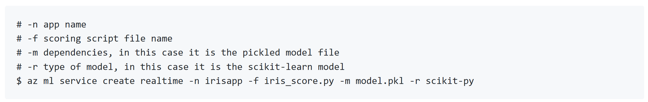
Manage models
Deployment and management of models as HTTP services
Container-based hosting of real time and batch processing
Management and monitoring through Azure (e.g., AppInsights)
First class support for SparkML, Python, CNTK, TF, TLC, R, extensible to support others (Caffe, MXnet)
Service authoring in Python and .NET Core
Notes:
Docker logo
Single node (on prem, cloud
ACS
Edge
MSFT ML Services
Spark cluster
SQL
Use slide 8 as reference
List

Slide 8
Deploy everywhere
Single node deployment (cloud/on-prem)
Azure Container Service
DOCKER
Azure IoT Edge
Spark clusters
Notes:
Docker container based deployment allows:
Single node deployment (cloud/on prem)
Clustered deployments via Azure Container Service
public preview target of 10k RPS on ACS cluster configuration
Currently have published models (via TLC) with <10ms latency
Edge deployment via Azure IOT Edge
Microsoft ML Server on-premises
Other deployment options
Spark clusters
Data engines:
SQL
CosmosDB (roadmap)
U-SQL (roadmap)
FPGAs (roadmap)
Serverless (roadmap)
Docker logo
Single node (on prem, cloud
ACS
Edge
MSFT ML Services
Spark cluster
SQL
Use slide 8 as reference
List

Slide 9
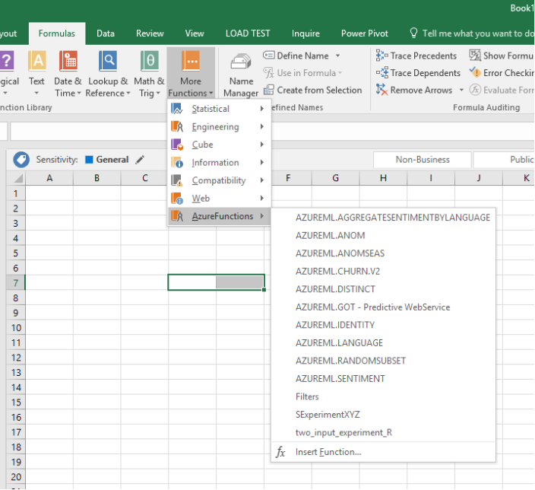
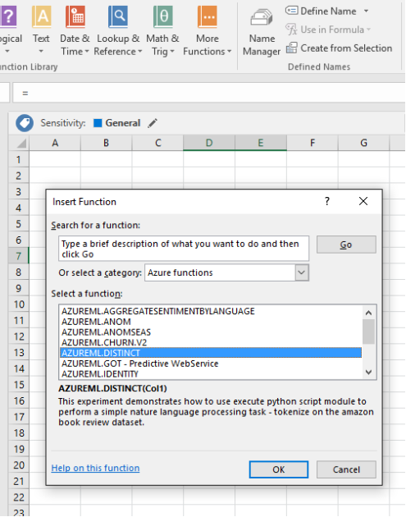
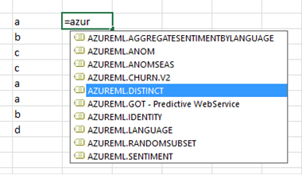
Consume Azure Machine Learning models in Excel

Slide 10

Boost productivity with agile development
Spend more time modeling and less time prepping with built-in intelligent data wrangling
Increase collaboration and sharing with notebooks and Git
Avoid losing anything with version control and reproducibility
Know the best performing models with metrics, lineage, run history, asset management, and more
Notes:
Spend more time modeling, less time prepping with built in intelligent data prep
Increase collaboration and sharing with notebooks and Git
Never lose anything with version control & reproducibility
Know the best performing models with metrics, lineage, run history, & asset management

Slide 11
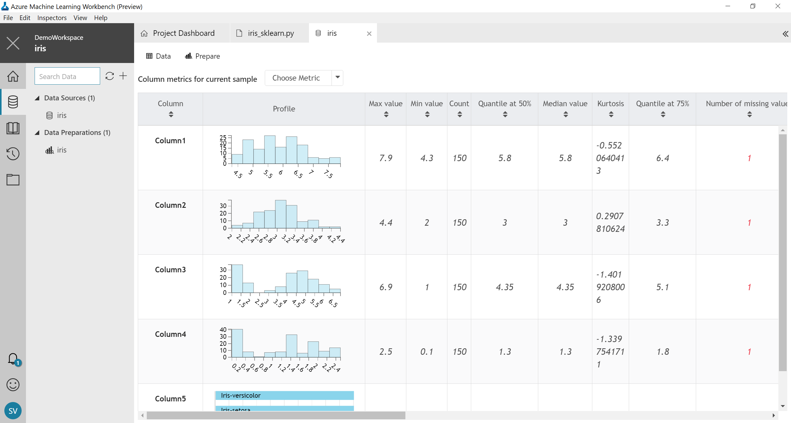
Prep data
Sample, understand, and prep data rapidly
Leverage PROSE SDK and more for intelligent, data prep by example
Extend/customize transform and featurize through Python
Generate Python and PySpark for execution at scale

Slide 12
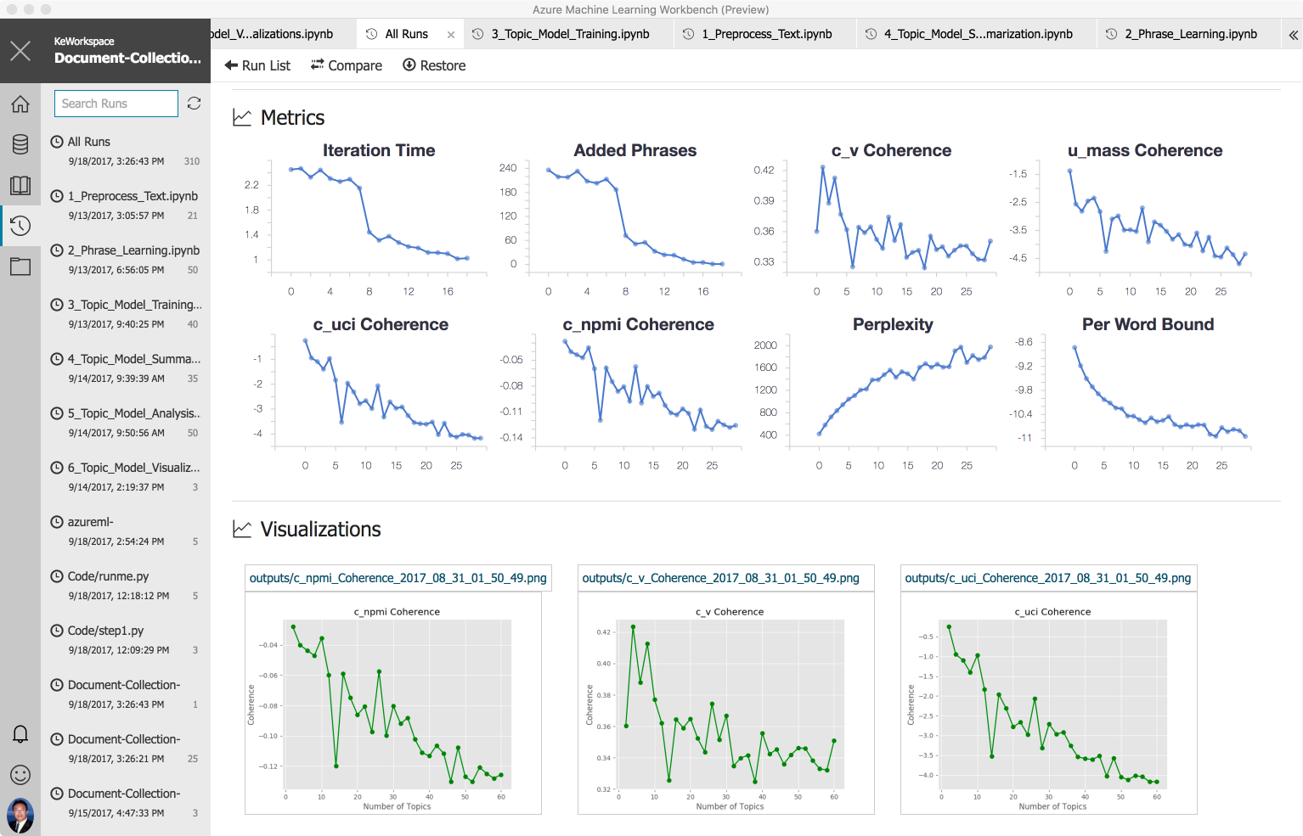
Experiment
Manage job for local and cloud experiments
Find support for Spark + Python + R (roadmap)
Execute jobs locally, on remote VMs (scale up), on Spark clusters (scale out), or SQL on-premises
Create with Git-backed experimentation tracking of code, config, parameters, and data
Discover and compare with detailed historical metadata

Slide 13

Begin building now with the tools and platforms you know
Choose between visual drag-and-drop or code-first authoring
Use your favorite IDE
Call Azure Machine Learning services directly in VS Code*
Build on any framework or library with the most popular languages
Train quicker and easier with industry-leading Spark and GPUs
*More IDEs coming soon
Notes:
Choose between visual drag-and-drop or code-first authoring with complete control
Use your favorite IDE, built into your favorite IDE (VS Code only @ Public Preview)
Use any framework or library and the most popular languages
Faster, easier training on industry leading Spark

Slide 14
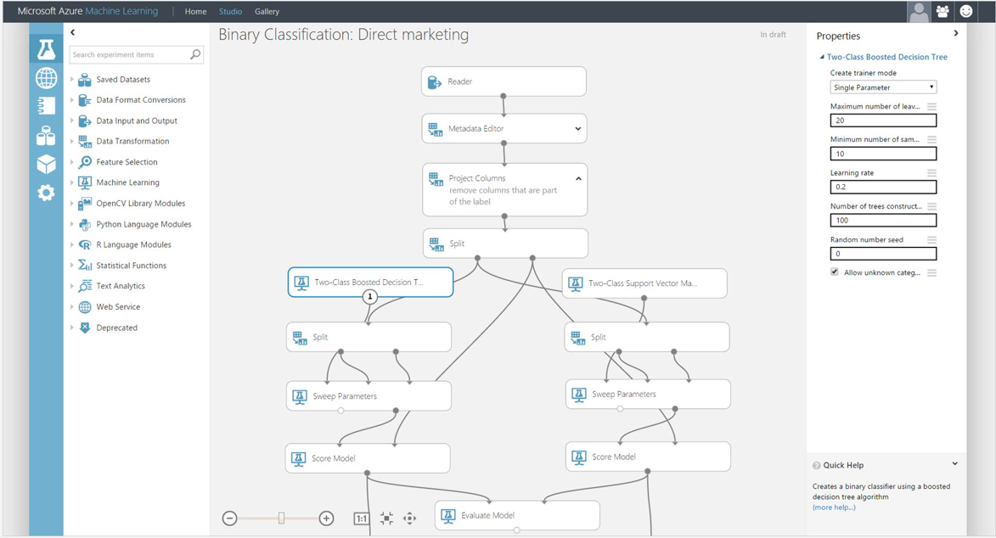
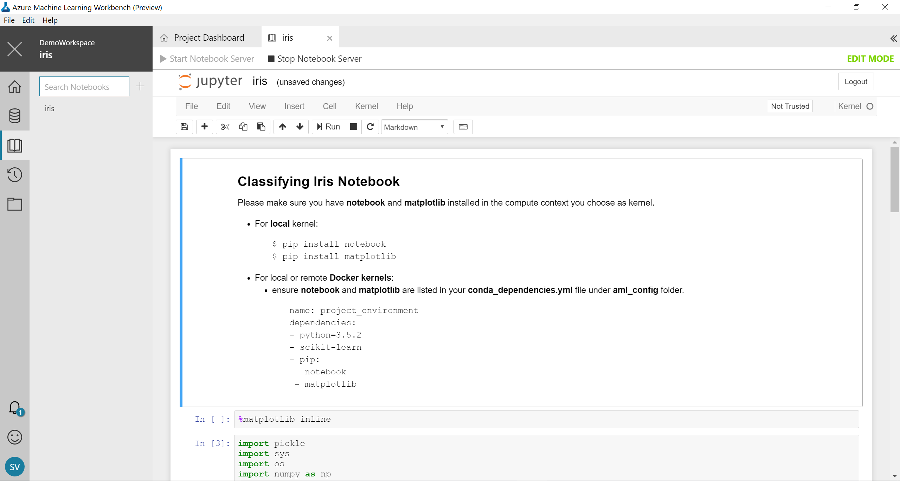
Build as you like
Visual drag-and-drop
Code-first

Slide 15

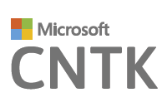
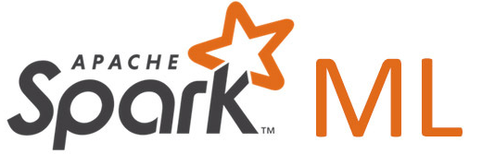
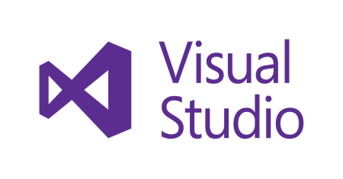







Use what you want
Use your favorite IDE
Leverage all types of data
Use any framework or library
Use any tool
Use the most popular innovations
Notes:
Any data, any framework. Tensorflow logo, CNTK logo, Spark logo
See inset for Tensorflow logo

Slide 16
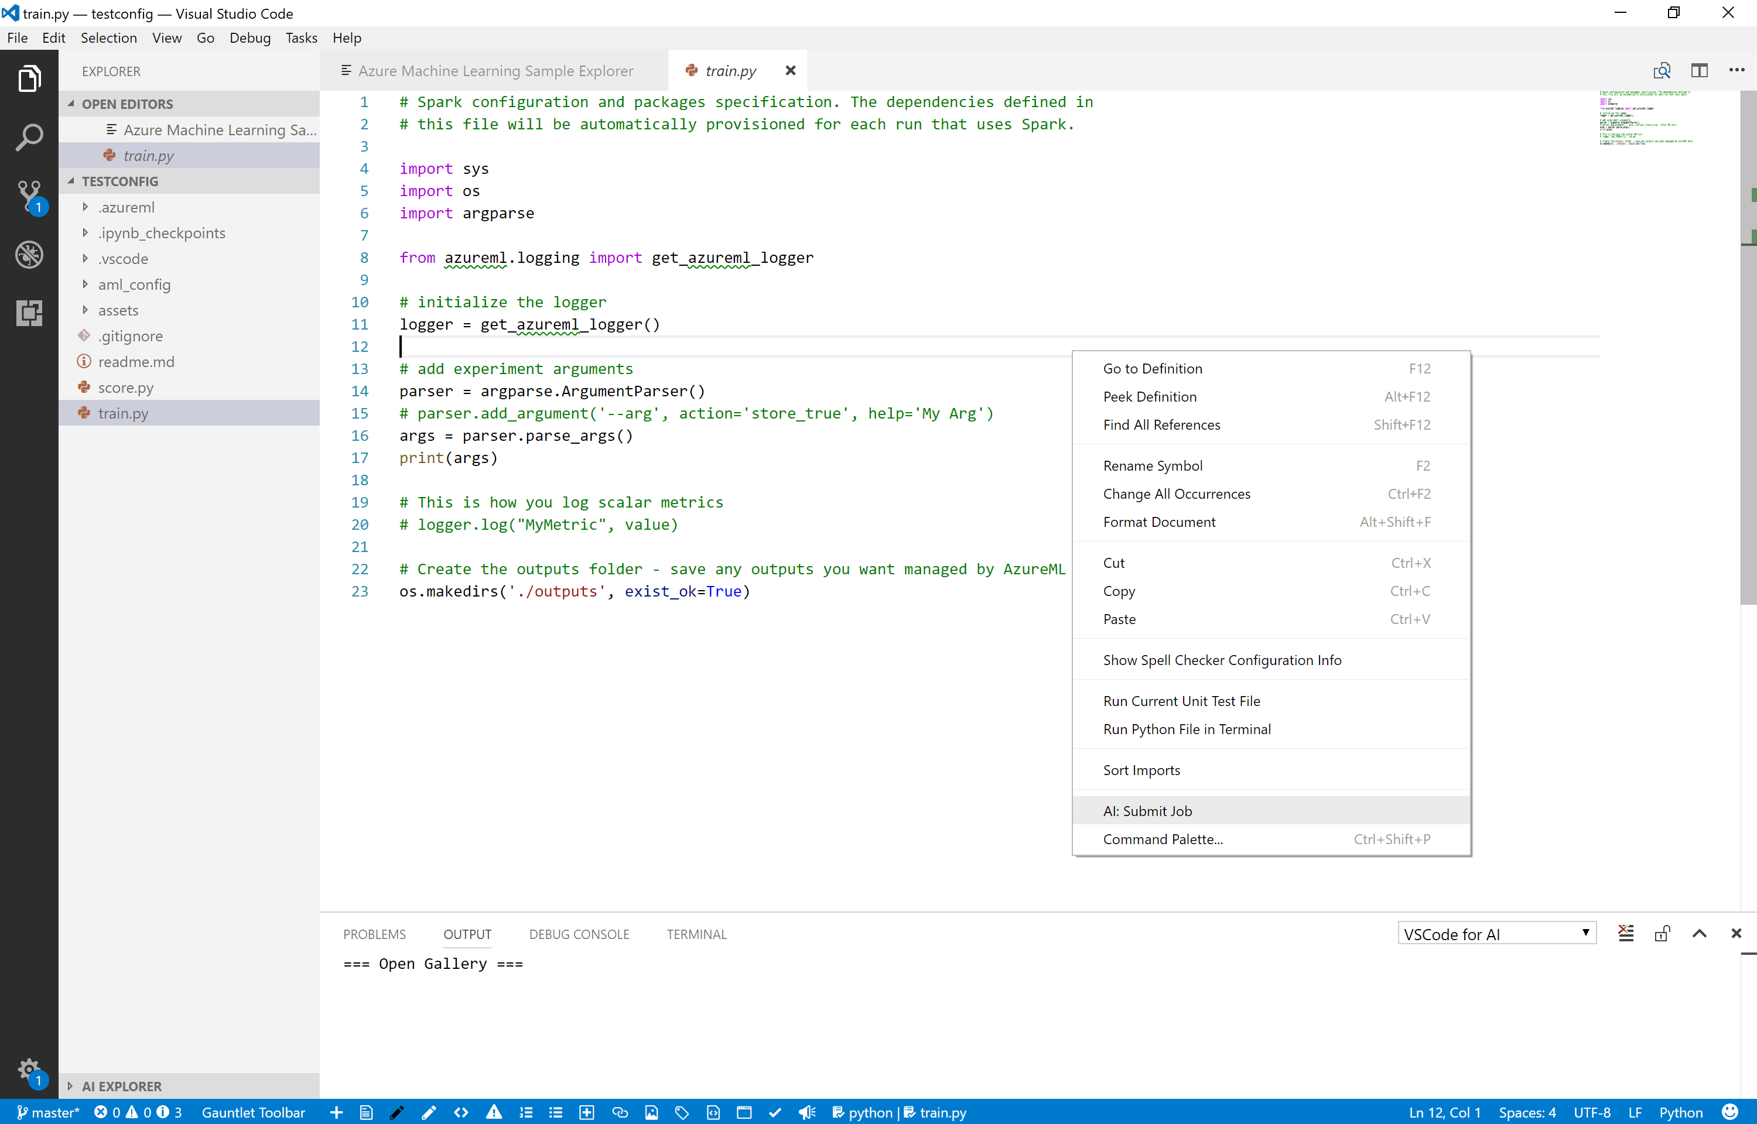
Integrated into your IDE
Visual Studio Code extension (more IDEs and notebooks on roadmap)
Begin building with your IDE - no extra tool needed
Integrated rich authoring for machine learning and deep learning
Call Azure Machine Learning services straight from your IDE or notebook
Notes:
A Visual Studio Code extension to:
Rich authoring for machine learning and deep-learning (Microsoft Cognitive Toolkit (CNTK), Google TensorFlow, and Berkeley Caffe)
Full-featured IDE for different DL languages across Windows, Linux and macOS
Manage compute targets (local, Docker, Virtual Machines, HDInsight Clusters)
Track run history and custom metrics
Reproducible experiments
Browse samples and create project with 1 click

Slide 17
Sample Patterns

Slide 18
Enhanced image classification Transfer learning, convolutional neural networks and gradient-boosting decision tree learning algorithms have redefined image classification
Azure Blob Storage
GPU Data Science Virtual Machine
Azure Container Registry
Azure Machine Learning Model Management Service
Azure Cluster Service
Predictive web application
Machine learning model
Java ETL
Notes:
Problem statement
Lean manufacturing, cost control, and waste reduction are imperative for manufacturing to remain competitive. In circuit board manufacturing, faulty boards can cost manufacturers money and productivity. Assembly lines rely on human operators to quickly review and validate boards flagged as potentially faulty by assembly line test machines. This solution analyzes electronic component images generated by assembly line cameras in a circuit board manufacturing plant and detects their error status. The goal is to minimize or remove the need for human intervention. The solution builds an image classification system using a convolutional neural network with 50 hidden layers, pretrained on 350,000 images in an ImageNet dataset to generate visual features of the images by removing the last network layer. These features are then used to train a boosted decision tree to classify the image as pass or fail and final scoring conducted on edge machines at the plant. The classification performance results are good (time based cross-validation AUC>.90) which indicates the solution is suitable to drastically minimize human intervention for electronic components failure detection in assembled circuit boards.
Key benefits
Improved identification of faulty electronic components.
Productivity enhancements as a result of failure detection automation

Slide 19
Improved text prediction Deep learning and natural language processing boosts search efficacy and tagging accuracy
Azure GPU Data Science Virtual Machine
SQL
Azure Machine Learning
Microsoft SQL Server
Azure Container Service
Azure Machine Learning Operationalization Cluster
Workbench
Experimentation Service
Web App (Jupyter Notebook)
Notes:
Problem statement
Social sites, forums, and other text-heavy Q&A services rely heavily on tagging, which enables indexing and user search. Without appropriate tagging, site efficacy is greatly diminished. Often however, tagging is left to a user’s discretion. Since users don’t have lists of commonly searched terms, nor understand the categorization or information architecture of a site, posts are frequently mislabeled. This renders content difficult or impossible to find. However, natural language processing in combination with data on site-specific search terms can greatly improve tagging accuracy. Appropriate tags are offered to users as they type.
Key benefits
Improve search efficacy
Suggest high-use terms
Improve tagging

Slide 20
Customer Story

Slide 21
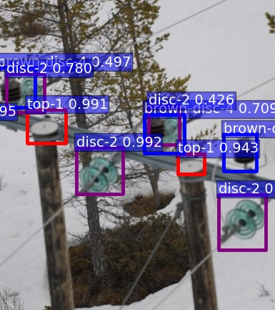

Drone-based electric grid inspector powered by deep learning
Challenge
Traditional power line inspection services are costly
Demand for low cost image scoring and support for multiple concurrent customers
Needed powerful AI to execute on a drone solution
Solution
Deep learning to analyze multiple streaming data feeds
Azure GPUs support Single Shot multibox detectors
Reliable, consistent, and highly elastic scalability with Azure Batch Shipyards
Notes:
https://blogs.technet.microsoft.com/machinelearning/2016/11/02/connected-drones-3-powerful-lessons-we-can-all-take-away/
Challenge
Power line inspection service based on drone collected imagery
Large scale image scoring service
Low cost per image
Support for multiple customers concurrently
Enable offline DNN model training
Consistency of training and deployment environments
Strategy
Offline DNN training (SSD/Caffe)
Highly elastic, scaling out solution based on Azure Batch Shipyards
Smart load distribution based on Azure Function
Consistency of environment by deploying Docker images
Flexible cost control on scalability parameters
Results
Connected Drone Product Launched on 6/1/17
Scalability at cost
Reliability and availability
Consistency with training environment

Slide 22

eSmart architecture
Data Sources
Ingest
Prepare
Analyze
Publish
Consume
Azure Functions
10 01
10 01
Azure Blob
Drone collected images
Batch upload of drone images
On-prem command center
Azure Blob
Raw storage
Azure Batch
Cosmos DB
Contain inventory results and state changes
Cosmos DB
Docker Image
DNN contained in a Docker image
Data
Intelligence
Action

Slide 23
Hands on Lab

